Slide 1
Music box音乐盒
Wang Chenyang
Xia Lei
Lv Rui
Luo Kai

Slide 2
catalog目录
Project Profile项目简介
equipment器件
Project successfully demonstrated功能展示
summary总结

Slide 3
Project Profile
complete a music box by using botton to
control LED LCD buzzer
通过按键控制 led lcd 蜂鸣器完成音乐盒

Slide 4
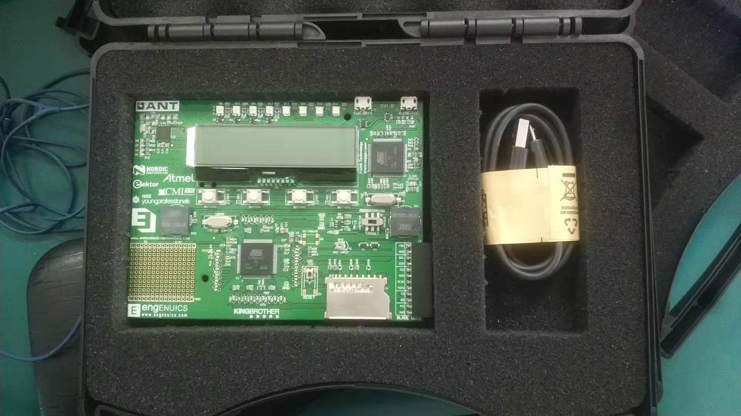
equipment
Single chip单片机
Data lines数据线

Slide 5
Project successfully demonstrated
music box function:
1,Play music 音乐
2,LCD flicker lcd闪烁
3,LED flicker led闪烁
4,LCD display word lcd显示文字

Slide 6
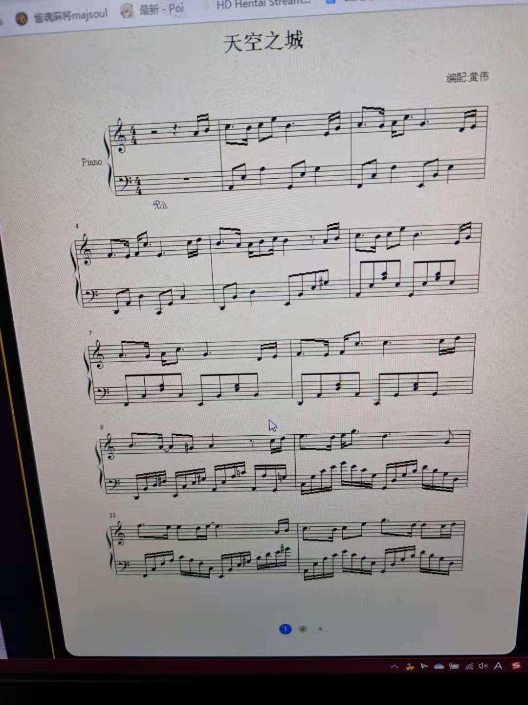
1,Play music
天空之城
Laputa:Castle in the sky
音符A4,B4,C5,B4,C5,E5,B4,E4,G4,A4,G4,A4,C5,G4,D4,E4,F4,E4,F4,C5,E4,C5,D5,D4,A4,A4,B4,C5,B4,NO,A4,B4,C5,B4,C5,F5,B4,E4,G4,A4,G4,A4,C5,G4,D4,E4,F4,E4,F4,C5,C5,C5,D5,B4,A4,A4,G4,A4,NO,C5,D5,E5,D5,E5,G5,D5,G4,F5,E5,E5,D5,E5,E5,A4,B4,C5,B4,C5,E5,G5,D5,D5,C5,D5
音符长度
QN,QN,QN,QN,QN,QN,QN,QN,QN,QN,QN,QN,QN,QN,QN,QN,QN,QN,QN,QN,QN,QN,QN,QN,QN,QN,QN,QN,QN,EN,QN,QN,QN,QN,QN,QN,QN,QN,QN,QN,QN,QN,QN,QN,QN,QN,QN,QN,QN,QN,QN,QN,QN,QN,QN,QN,QN,QN,EN,QN,QN,QN,QN,QN,QN,QN,EN,QN,QN,QN,QN,QN,QN,QN,QN,QN,QN,QN,QN,QN,QN,QN,QN,QN
每个音符类型
ST,ST,RT,RT,RT,RT,HT,ST,ST,RT,RT,RT,RT,HT,ST,ST,RT,RT,RT,RT,HT,ST,ST,RT,RT,RT,RT,RT,HT,HT,ST,ST,RT,RT,RT,RT,HT,ST,ST,RT,RT,RT,RT,HT,ST,ST,RT,RT,RT,RT,HT,ST,ST,RT,RT,RT,RT,HT,HT,ST,ST,RT,RT,RT,RT,HT,HT,RT,RT,RT,ST,ST,HT,ST,ST,RT,RT,RT,RT,RT,RT,RT,ST,ST

Slide 7
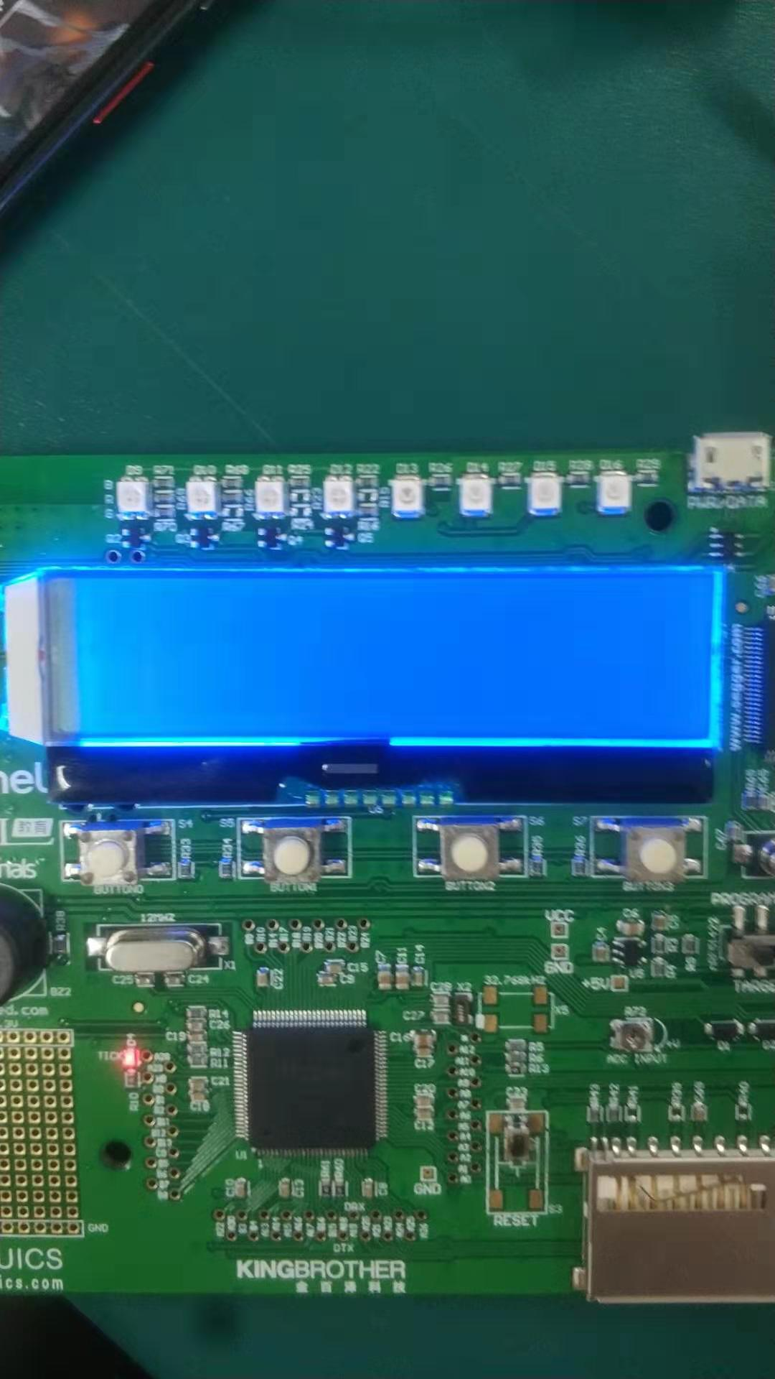
2,LCD flicker
Press Button1

Slide 8
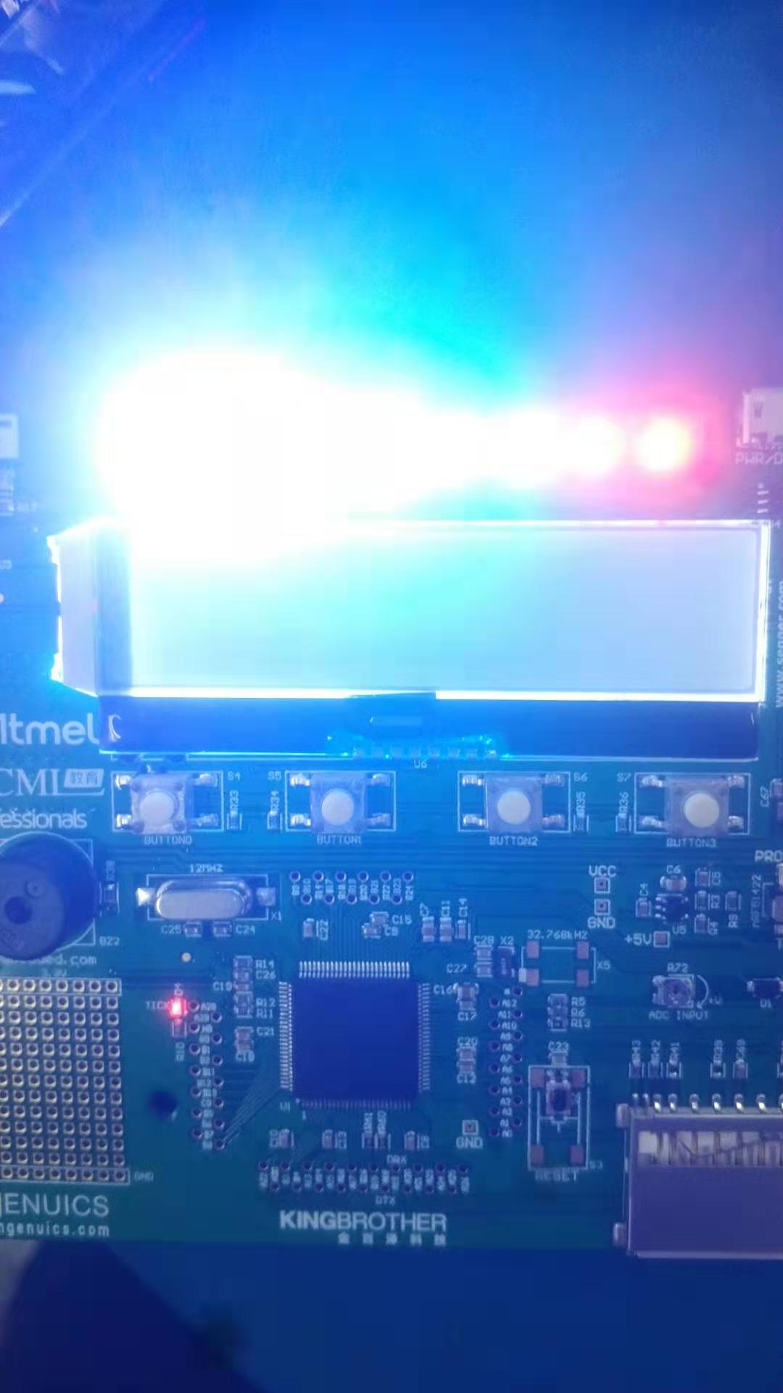
3,LED flicker
Press Button2

Slide 9
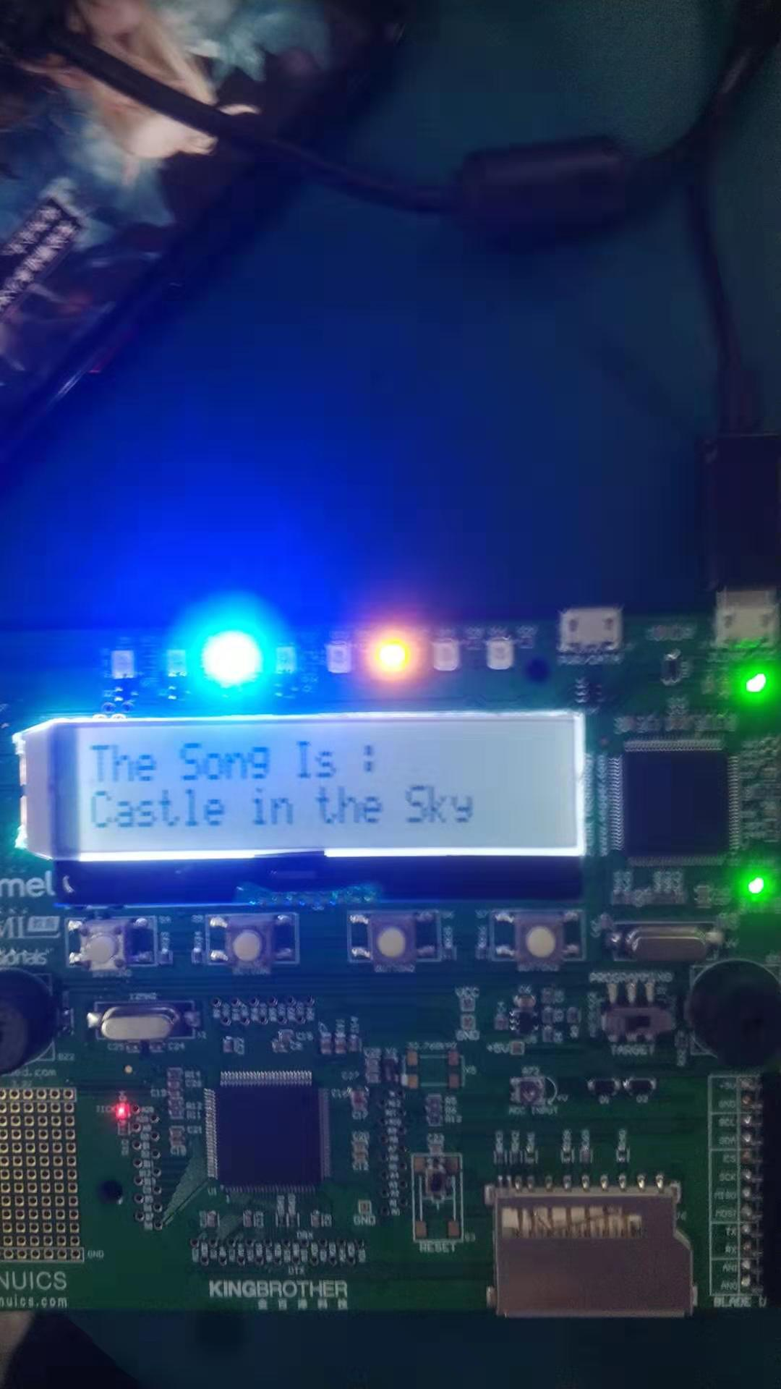
4,LCD display word
Press Button3
（It could switch what’s display on it）

Slide 10
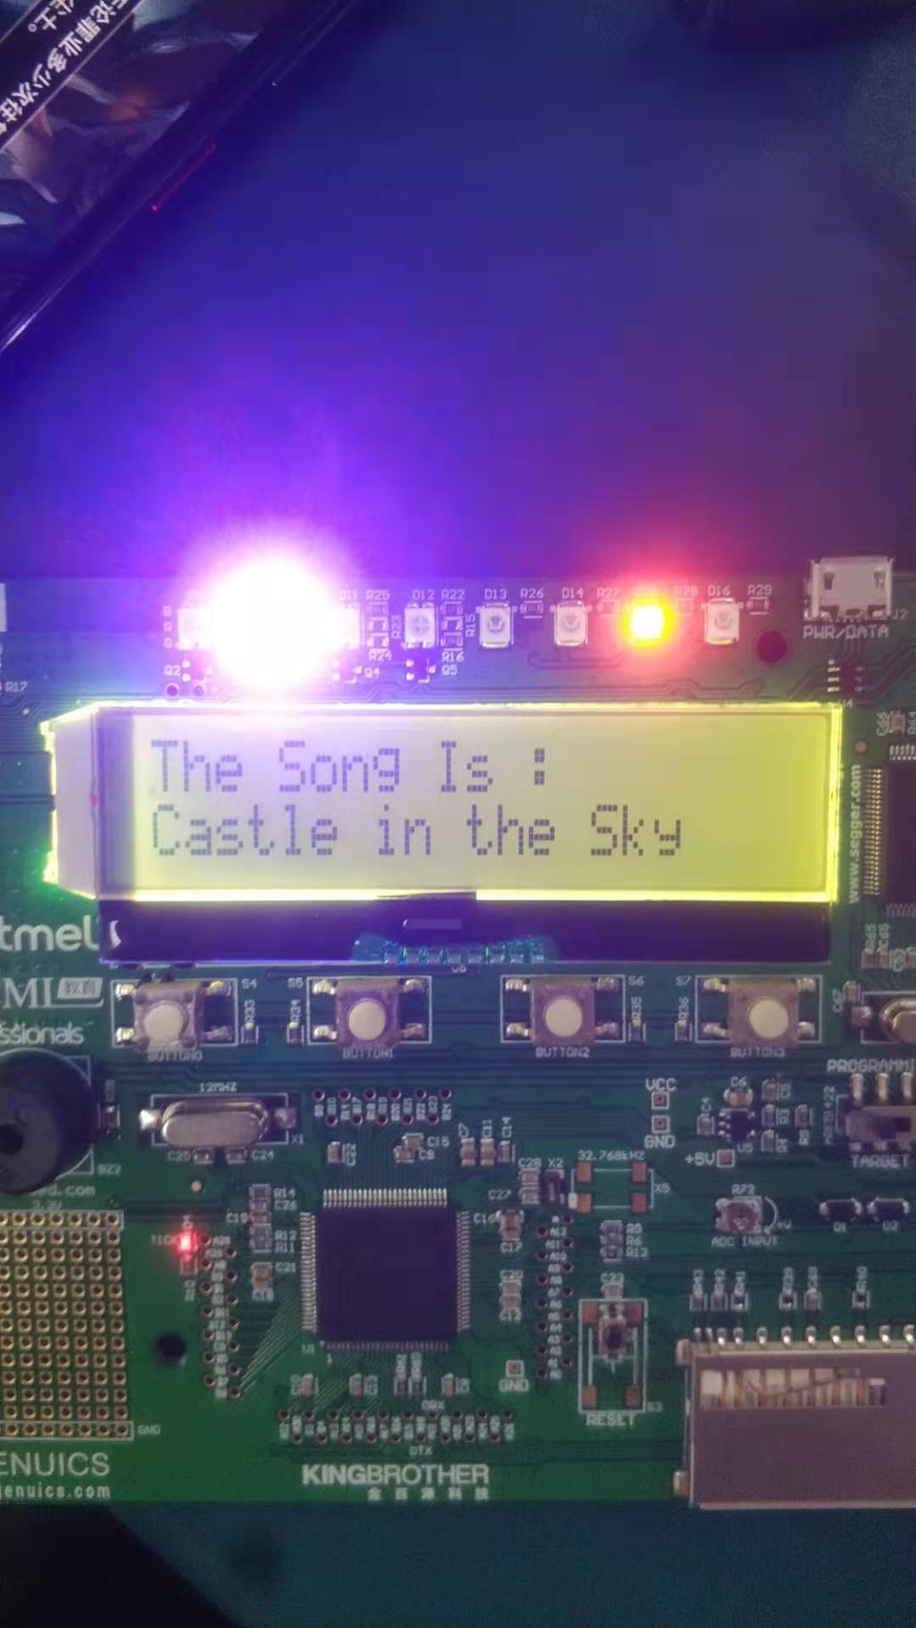
Summary
we are so glad to attend the class
we have learnt a lot new knowledge
we work together to solve problem
thanks teachers

Slide 11
Problem
We try to add other songs into the code,but it doesn’t work and we don’t have enough time to solve it.
And the most difficult part is turn notes into code,it will take a lot of time.
So it only has one song in this code.

